Slide 1
BHARATHIAR UNIVERSITY, COIMBATORE
DEPARTMENT OF COMPUTER APPLICATIONS
FACE EMOTION DETECTION SYSTEM
Under the guidance of , Project by,
Dr. S. GAVASKAR, MCA., Ph.D., NAGARAJAN M
Assistant Professor, 22CSEA59
Department of Computer Applications II MCA - BATCH I

Slide 2
ABSTRACT
The Face Emotion Detection System (FEDS) is a real-time computer vision solution designed for emotion analysis in human faces. FEDS uses advanced machine learning to accurately identify emotions like happiness, sadness, anger, surprise, fear, and disgust. Its pipeline includes facial detection, landmark identification, and emotion classification. Trained on diverse datasets, FEDS demonstrates high accuracy across demographics and lighting conditions. This system has applications in human-computer interaction, sentiment analysis, and psychological research, enhancing the development of emotionally intelligent technologies.

Slide 3
OVERVIEW
The Face Emotion Detection System (FEDS) focuses on understanding human emotions in real-time to improve interactions with computers. It consists of three main parts: finding faces, locating features, and identifying emotions. FEDS, powered by machine learning and computer vision, currently detects faces well, pinpoints facial features accurately, and classifies various emotions. Future plans include adding voice and gesture recognition, continuous improvement based on user feedback, and ensuring adaptability across different cultures. FEDS finds applications in human-computer interaction, sentiment analysis, and psychological research. In essence, FEDS is an evolving system aiming to make technology more emotionally intelligent for a smarter and responsive future.

Slide 4
HARDWARE SPECIFICATION
PROCESSOR : AMD Ryzen 5 5600H with Radeon Graphics 3.30 GHz
RAM : 16.00 GB
HARD DISK : 512 GB
MOBILE : Android
SOFTWARE SPECIFICATION
OPERATING SYSTEM : Windows 11
SOFTWARE : vs code
LANGUAGE : python
EMULATOR : Android

Slide 5
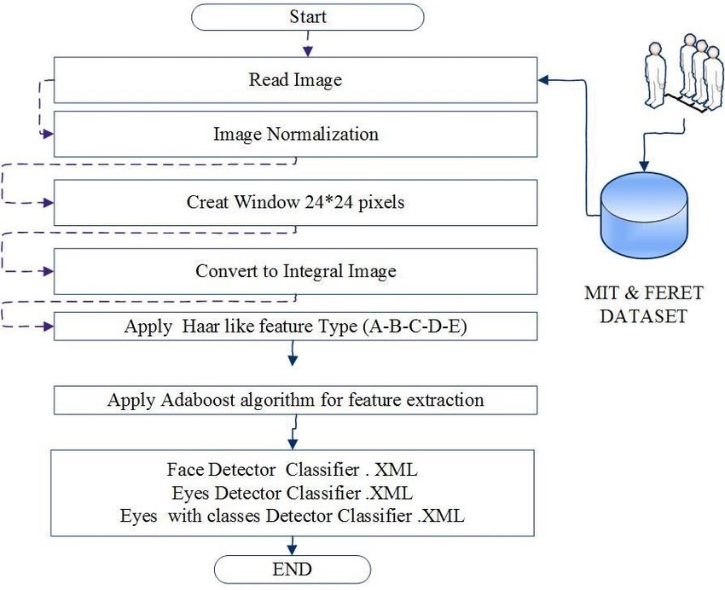
FLOW DIAGRAM

Slide 6
FACE EMOTION RECOGNITION DATASET
The FER+ dataset is a notable extension of the original Facial Expression Recognition (FER) dataset. Developed to improve upon the limitations of the original dataset, FER+ offers a more refined and nuanced labeling of facial expressions. While the original FER dataset categorized facial expressions into six basic emotions – happiness, sadness, anger, surprise, fear, and neutral– FER+ takes this a step further by introducing two additional categories: neutral and contempt.

Slide 7
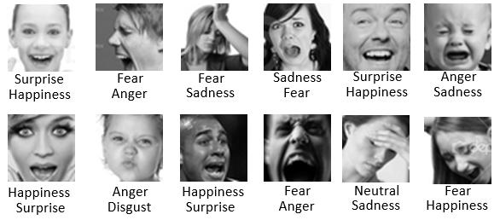

Slide 8


Slide 9
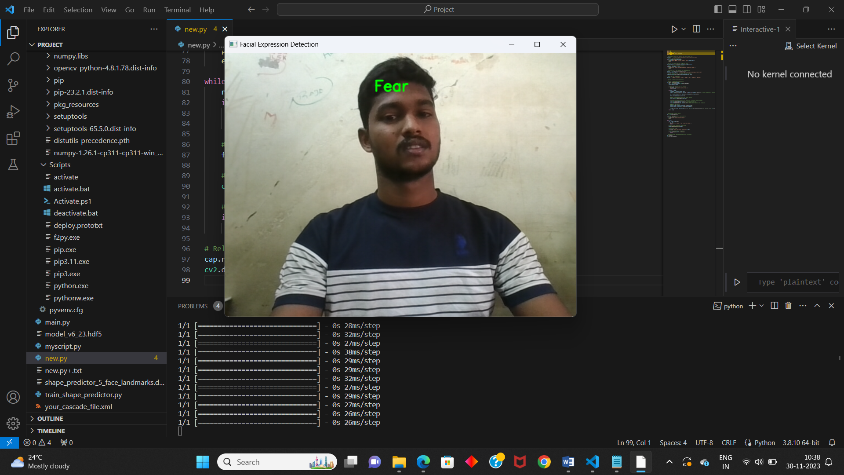

Slide 10
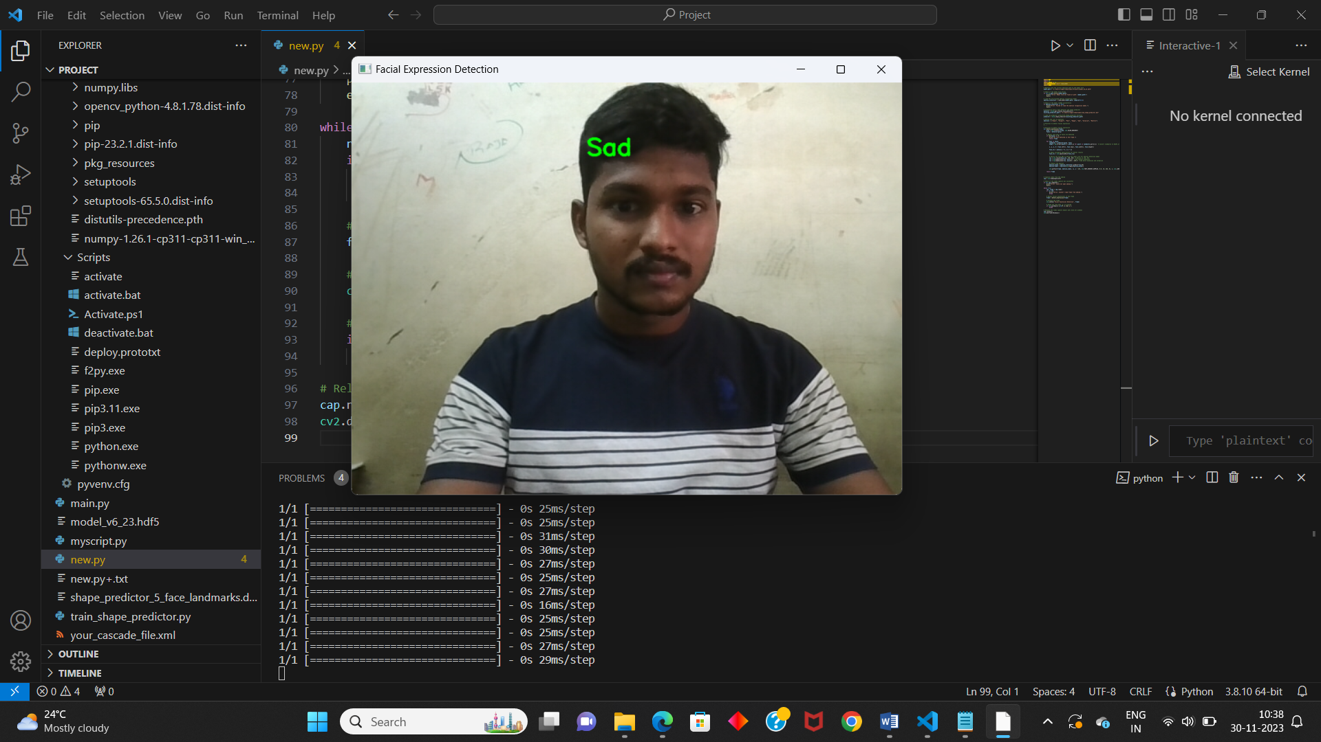

Slide 11
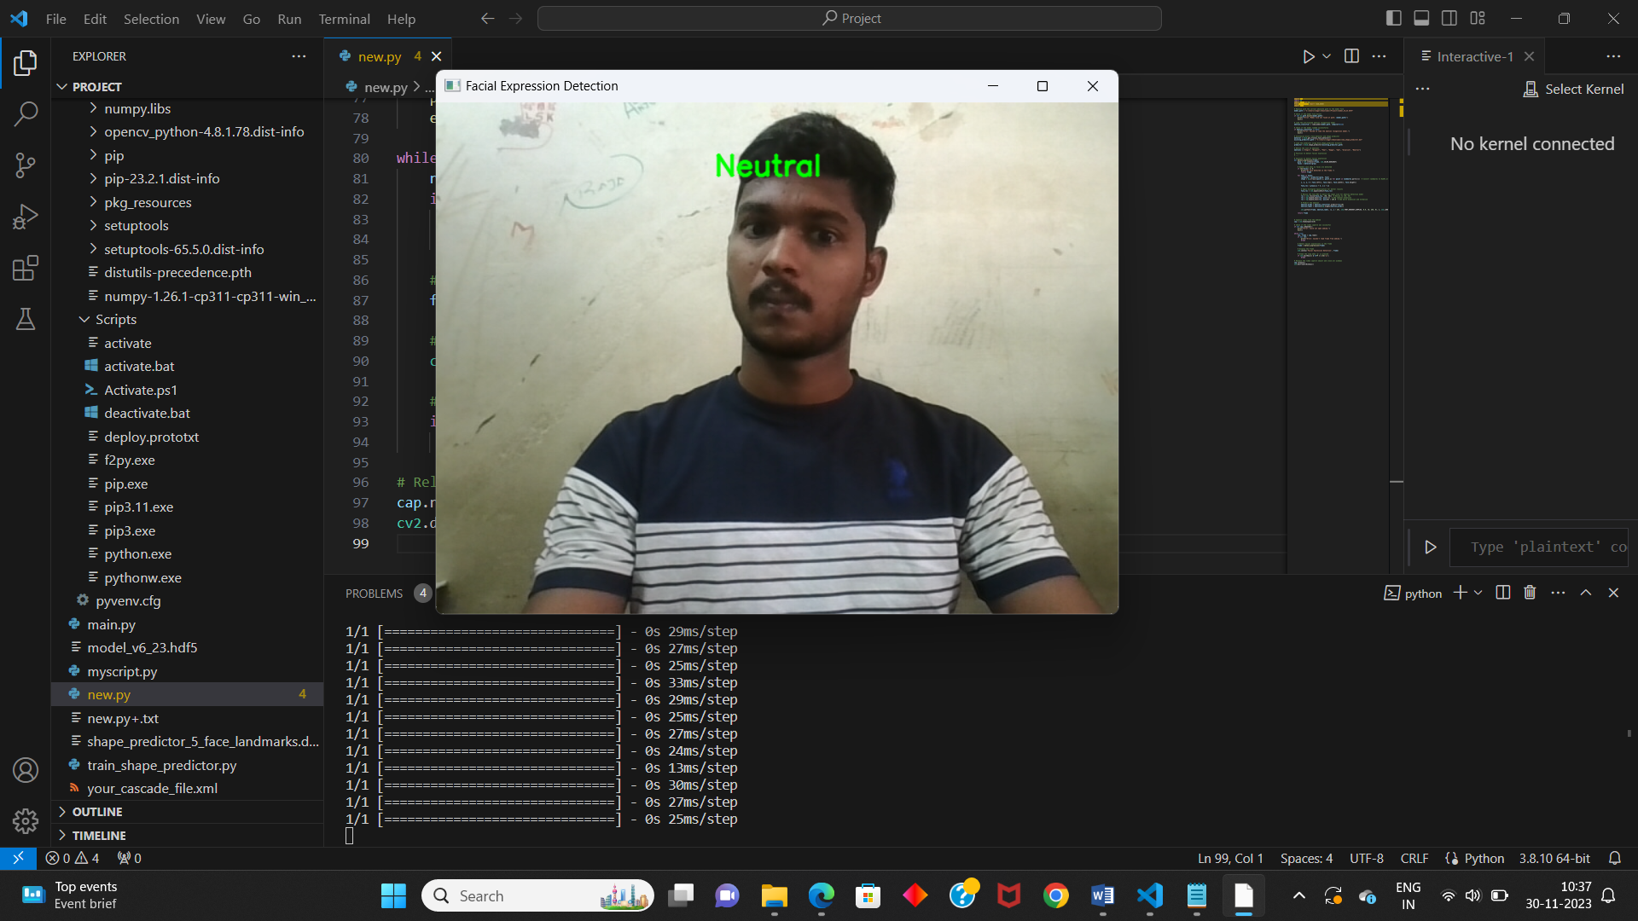

Slide 12
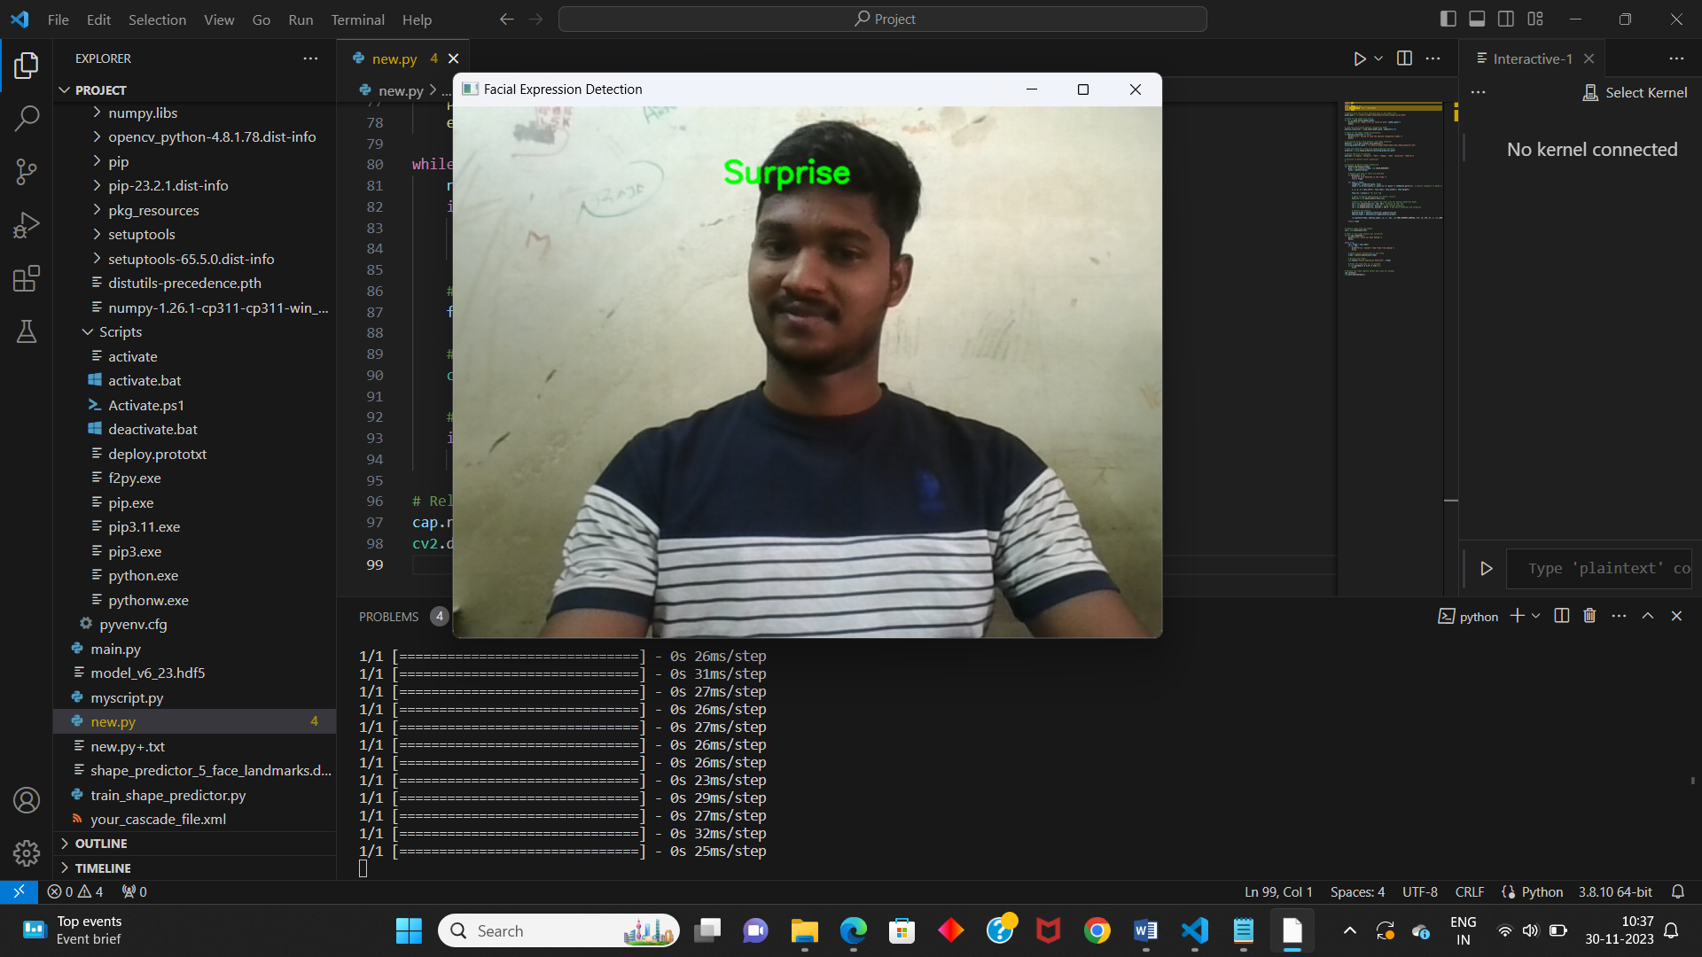

Slide 13
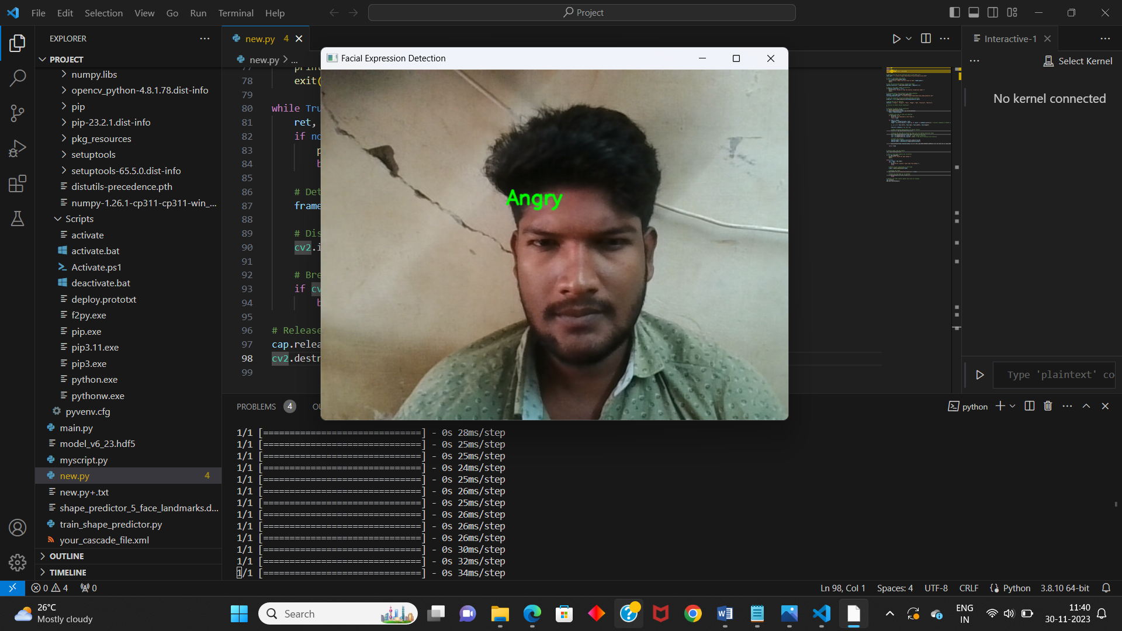

Slide 14
FUTURE ENHANCEMENT
Add More Senses:
Include voice and gesture recognition for a fuller understanding of user emotions.
Learn and Improve in Real-time:
Set up a system that gets better over time by learning from user interactions.
Understand Everyone:
Make sure the system can recognize emotions across different cultures.
Faster and Private:
Make the system work faster and keep it private by using edge devices.
Stay Up-to-date:
Keep the system in the loop with fresh data to understand new expressions.
Explain It Clearly:
Help users trust the system by explaining how it makes decisions.

Slide 15
CONCLUSION
The Face Emotion Detection System (FEDS) is at the forefront of real-time emotion analysis.
With precise facial detection and emotion classification, the current system is robust.
Future enhancements, such as adding voice and gesture recognition, aim to make FEDS even more versatile and user-friendly.
Our commitment is to create a system that adapts to user needs, embraces new technologies, and stays ahead in emotion analysis.
FEDS is poised to play a key role in the journey towards a more emotionally intelligent future.
Our goal is a future where technology seamlessly understands and responds to human emotions, enriching our digital interactions.

Slide 16
THANK YOU

